Slide 1
Business Intelligence and Business Analytics (H9BIBA)

Slide 2
Module Content
Intelligent Enterprises
Agile Enterprises, Operating Strategies, Continuous Improvement Programs
Enterprise Systems
Evolution – MRP, CL MRP, MRP II, ERP, ES Packages, Balanced Scorecard
BI and Dashboards
Views v Reports, Types of Dashboards, Advantages of Dashboards, The Funnel
Consumer Behaviour models
Behaviourist v Cognitivist, Lawson’s, EKB, and Howard and Sheth’s models
Operational CRM Systems
Overview and Demo of a commercial system such as Microsoft Dynamics CRM
Implementing Enterprise BI systems
Data Warehousing and Data Marts, Data mining, Online Analytical Process (OLAP)
Implementing CRM systems
Fit-Gap Analysis, Integration with Heterogeneous systems, Data integration, Information Lifecycle Management, Data protection, security and ethical considerations
Customer-Centric Enterprise with CRM
Customer Experience, Customer Loyalty, Customer Relationships, Customer Life Cycle, Customer Value Management
Customer-Responsive Enterprise with SCM
Supply Chain Management, Customer-Responsive Management, B-Webs, Activity Costing techniques
Renewing Enterprise with PLM
Components and Advantages of PLM, Porter’s Framework, Product Life Cycle
Collaborative Enterprise with BPM
BPM, BPR, Business Processes with SOA, Workflows, Analytics
Informed Enterprise with BI
Context-Aware Applications, Decision Patterns and Data mining

Slide 3
Today
Operational CRM Systems
Overview and Demo of a commercial system such as Microsoft Dynamics CRM

Slide 4
Customer relationship management (CRM)
Can be defined as a comprehensive approach to customer relationship management.
All concepts a company employs to manage its relationship with customers including attracting and analyzing them as well as satisfying their needs.
There are different types of CRM packages to accommodate customer relationship management including everything to do with customer service, setting up policies and processes, training of employees, marketing, and systems management.

Slide 5
CRM continue …
To choose the best CRM tool for a company, first, one needs to consider the specific needs of the company.
CRM solutions increase your profitability by streamlining administrative processes and letting you focus on building and maintaining the customer relationships that matter.
A strong CRM solution is a multifaceted platform where everything crucial to developing, improving, and retaining your customer relationships is stored.

Slide 6
What is operational CRM?
Operational CRM can be defined as all the services that allow a business organization to take care of customers’ needs.
The system connects and supports an organization’s sales, marketing, and customer service functions, thus building a framework that provides customer support.
In simple terms, your organization’s CRM is the lifeline connecting your brand, team of employees, and the prospective customers.

Slide 7

Why consider CRM at all?
Because Customers Drive Business Success.
Effectively managing the customer lifecycle – from marketing to sales to service – is critical to every company’s profitability and growth.
“… companies with high customer satisfaction scores have blown the S&P 500 out of the water, especially over the last few years. Not only have they produced higher stock returns, but their stock values and cash flows have been less volatile.”

Slide 8
Traditional CRM projects don’t always work out
“Spending has reached
an all-time high, with expectations nearly as
lofty. But implementation
failure rates have not improved.”
“User adoption
remains a challenge, with 33% to 47% of customer management applications facing serious adoption issues.”

Slide 9
Perceptions of CRM for smaller organizations
• “CRM is just too complex for my business”
• “Only the big companies use CRM”
• “It’ll cost me way too much”
• “You go through all this trouble and no one uses it anyway”
• “I’ll have to change everything about my business”
• “I don’t have the technology or the team to make CRM work”

Slide 10





What to look for in a CRM system?
CRM that fits your people
The right user experience for every user role
CRM that fits your business
Configures easily to meet your specific organization size
CRM that fits your budget
Deploys quickly and is affordable for your business

Slide 11

How do you get started?
Be in the “Know”!
Know your desired outcomes
Know your business and your critical processes
Know when to connect with an expert
Know your options

Slide 12

Know your desired outcome
What do I want out of a CRM system?
Increase revenues and profits?
Get better information about my customers?
Track sales opportunities?
Measure performance of my teams?
Gain consistency/repeatable processes across teams?

Slide 13
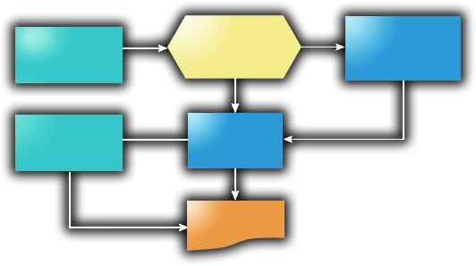
Know your business and critical processes
What makes my business tick?
Are we doing the same steps each time?
Do we have redundant processes between teams?
What can be – or shouldn’t be – automated with CRM?
Will I have to change my business to use a CRM system?

Slide 14

Know when to connect with an expert
What do I need help with?
Determining if CRM is a fit for my business?
Documenting what makes my business really run?
Learning from the experiences of other CRM projects?
Adapting a CRM system to my business needs?

Slide 15

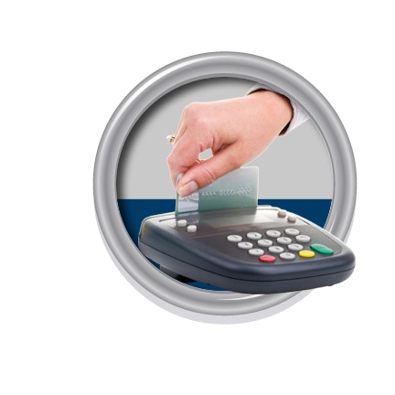

Why Microsoft Dynamics CRM ?
Works the way
you do
Deliver an easier and more natural user experience
Works the way
your business does
Deliver a system that matches the way you do business
Works the way
technology should
Deliver an affordable solution that fits your business

Slide 16
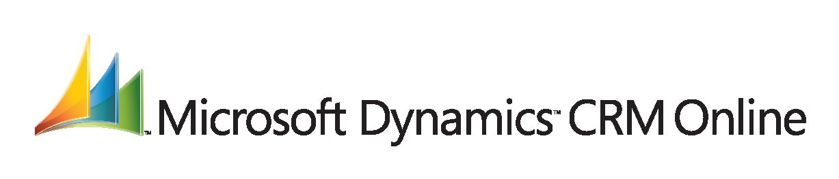

What is Microsoft Dynamics CRM Online?
Full functionality of Microsoft Dynamics CRM - over the Internet
Technology managed by Microsoft on your behalf
Monthly fee model for reduced up-front technology investment
Secure, on-line access anywhere with web access

Slide 17

When to consider Microsoft Dynamics CRM Online?
Organizations wishing to deploy a solution rapidly on-line
Companies with limited or no IT availability
Rapid-start evaluation projects before larger deployment
Organizations with limited technology infrastructure in place
From 5 to 250 potential CRM users
Prefer a monthly fee model

Slide 18
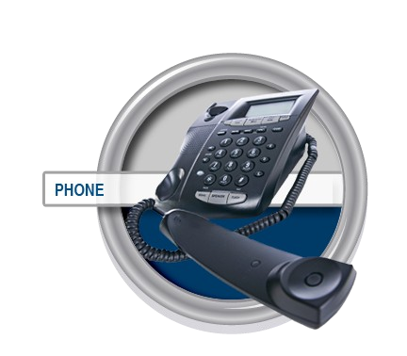
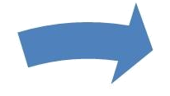
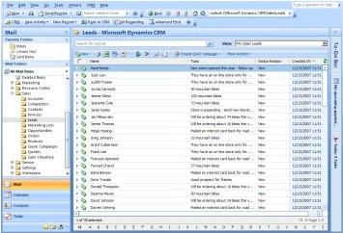


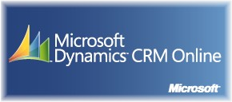



Drive Fast and Productive Sales
A lead is automatically created with the appropriate sales workflow.
A prospect requests more information.
The lead is
automatically
routed to inside sales to qualify and assign.
The lead is passed to the right sales person to close the opportunity.

Slide 19

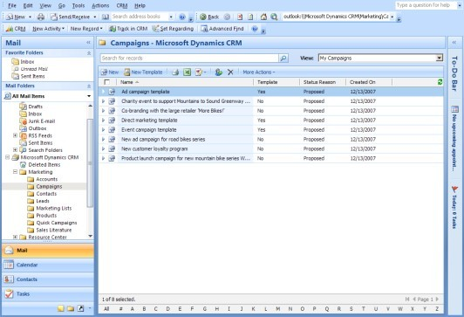
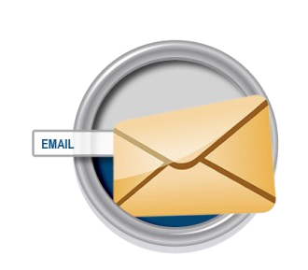

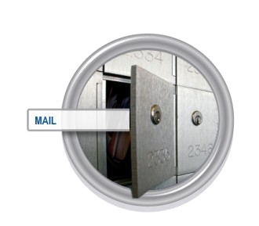
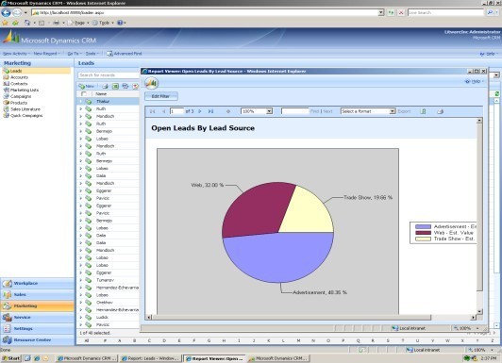
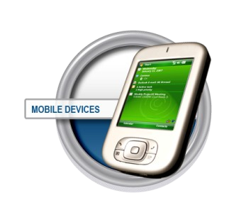
Drive Fast and Effective Marketing
A new campaign is budgeted, approved, targeted, and executed to your target audience
Campaign responses are captured;
performance is measured
for evaluation

Slide 20

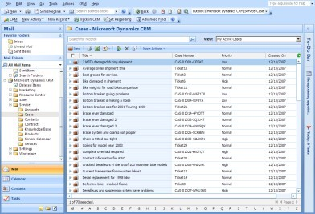
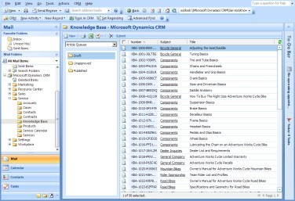
Drive Fast and Consistent Customer Service
The service case is created with an appropriate service workflow.
Service requests come in via phone, web, or other channels.
The service request is automatically routed to the
best available agent.
The knowledge base
is searched and solutions are suggested.

Slide 21


Why Choose Microsoft CRM?
“If you know how to use any of Microsoft’s desktop tools, you know how to use Microsoft’s CRM product.”
““Buyers also like Microsoft Dynamics CRM’s usability and its quick time-to-value compared with traditional CRM applications.”
““Buyers also like Microsoft Dynamics CRM’s
usability and its quick time-to-value
compared with traditional CRM applications.”
- Forrester Research, February 2007

Slide 22

Try Microsoft Dynamics CRM Online for Yourself
•
•
•
•
Full functionality of Microsoft Dynamics CRM - over the Internet
Technology managed by Microsoft on your behalf
Monthly fee model
Secure, on-line access anywhere with web access

